Slide 1
Dishcovery
Lab Usability Test
Abena Ofosu, Sharon Wambu, Kayla Kelly, Defne Genc

Slide 2
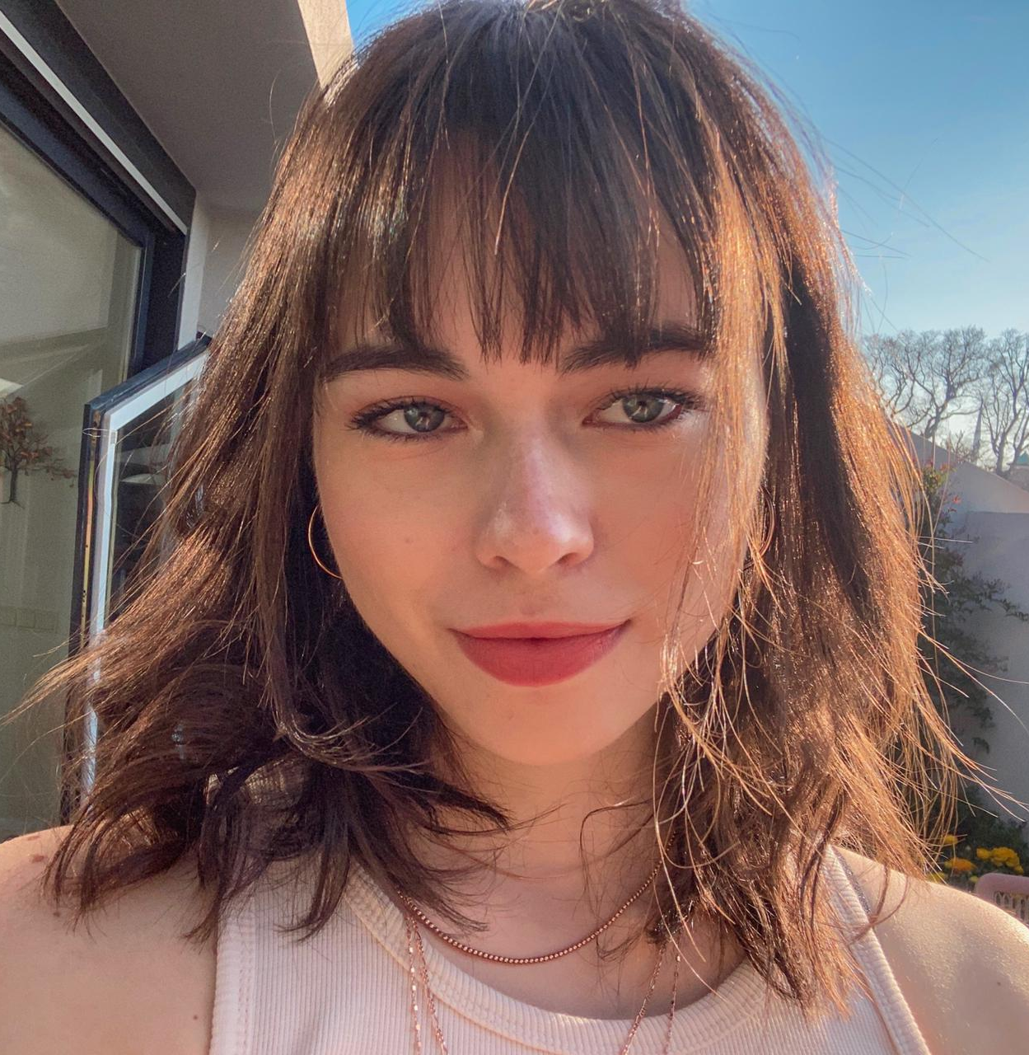
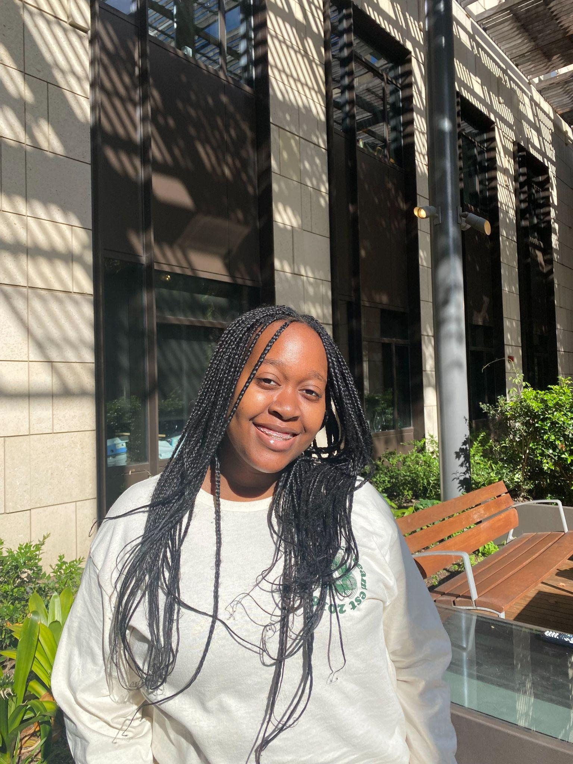
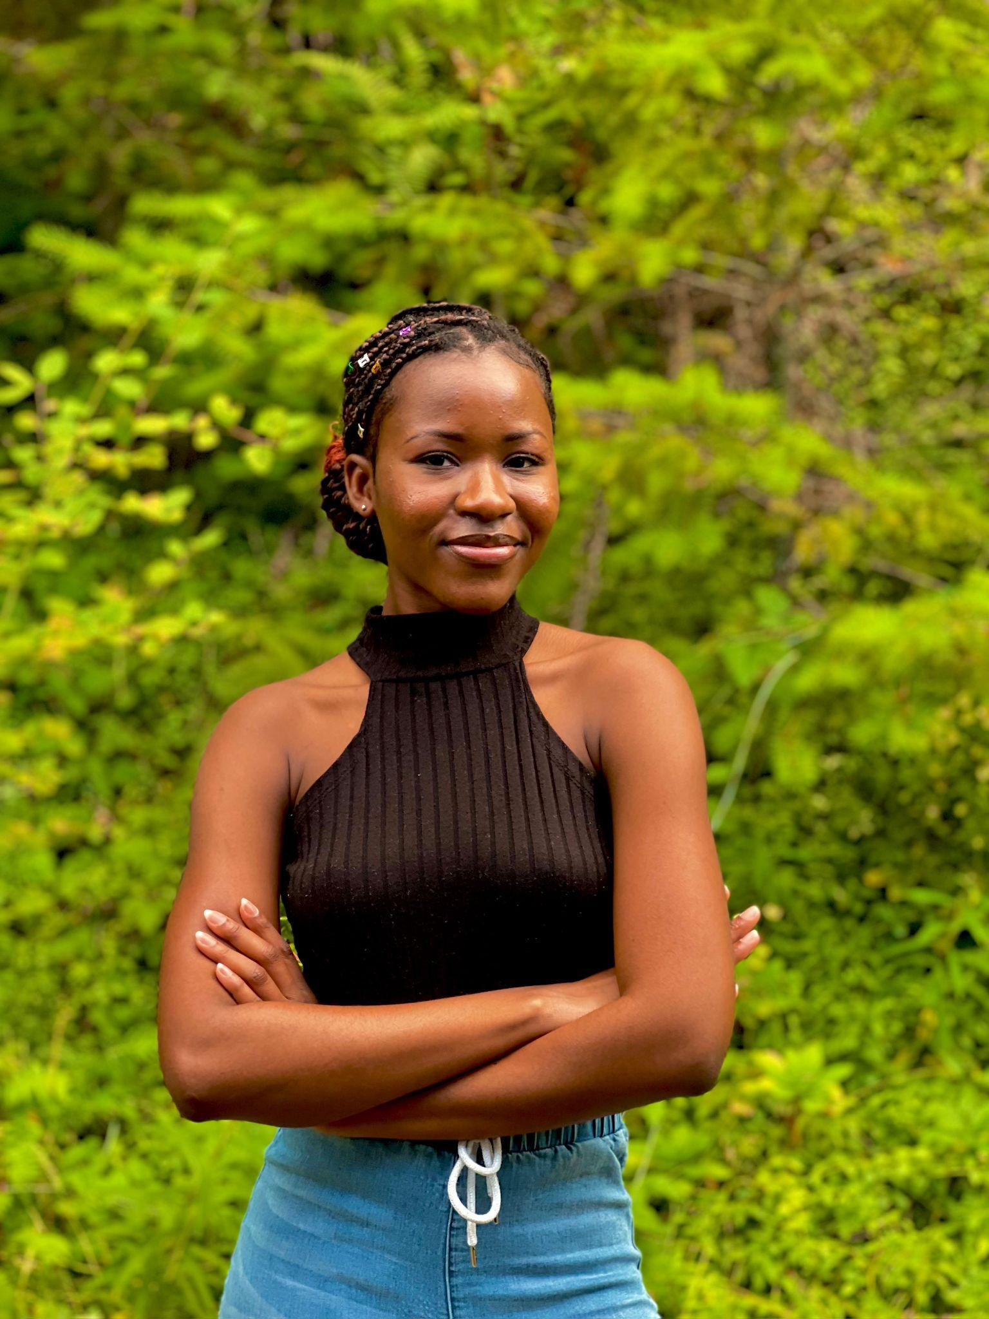
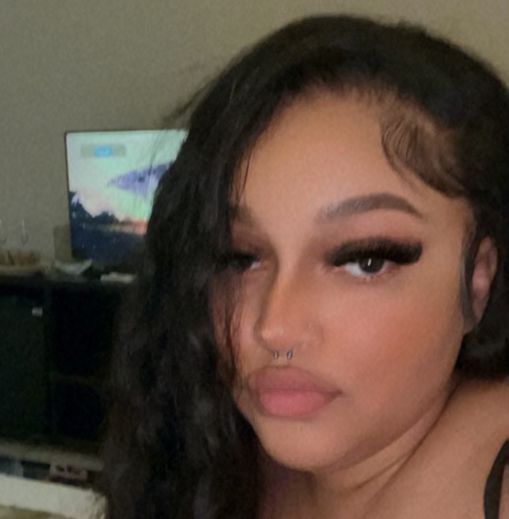
Our Dishcoverers
Defne
Sharon
Abena
Kayla
Dish of choice:
Dish of choice:
Dish of choice:
Dish of choice:

Slide 3
Presentation Outline
Prototype Changes
01
Analysis
04
Methodology
02
Future Trajectory
05
Results
03
Improvements to our interface.
Making sense of our results.
How we conducted our tests.
What we want to improve and implement.
The data we collected.

Slide 4
01
Initial Prototype Changes

Slide 5
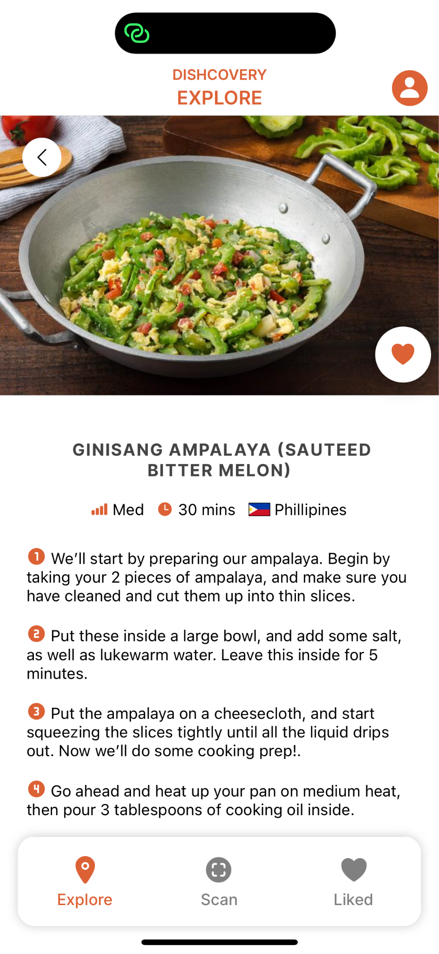
Content changes
Our updated prototype included a new hard-coded recipe for our participant, Jerri, who cooked with the bitter melon. Her ginisang ampalaya dish is now one of the two recipes currently readily available on the app.

Slide 6
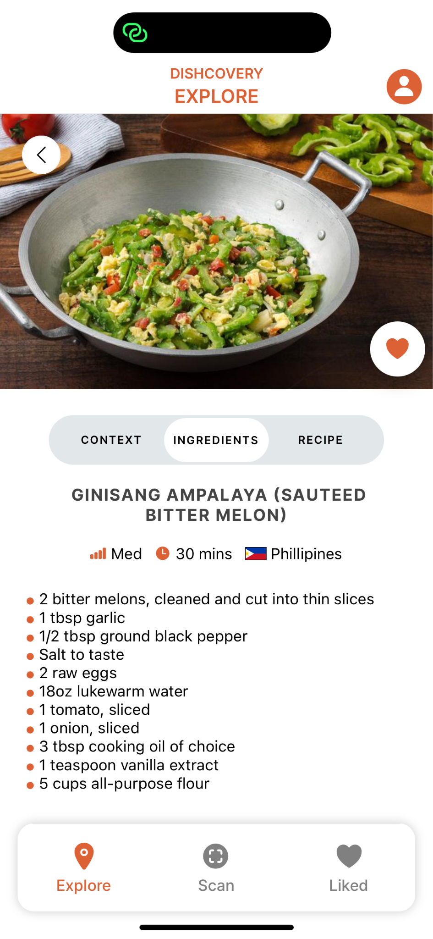
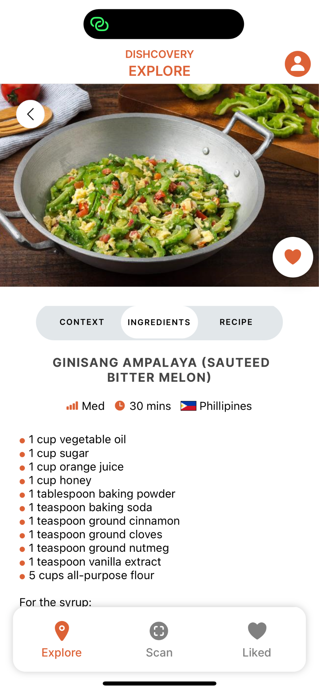
Before
After

Slide 7
Implementation changes
We needed to renew our Clarifai API to be able to keep scanning, and in some cases, Expo had trouble resolving dependencies.
To troubleshoot this, some of our participants used the offline version, but all but one of our tests were able to use the online version.

Slide 8
02
Methodology

Slide 9
We interviewed participants who varied in…
Experience cooking food.
Cultural background.
Age and occupation.
Comfort levels with cultural cooking.
Notes:
Some who have experience and some who do not, 3 of of which are students and one who is not

Slide 10
Recruitment
Word of mouth
We made use of our social networks to recruit participants.

Slide 11
Overview of participant profiles
Software Engineer
Undergraduate
Who loves to cook dishes from home.
International student from Uganda who yearns for food from their cultural background
Undergraduate
Undergraduate
Who enjoys cultural cooking but has never travelled or tasted authentic food outside of a restaurant.
Who enjoys trying new cultural recipes but has trouble finding ones that fit with her dietary restrictions

Slide 12
Testing methods.
1. Pantomime Test.
2. Cooking test.
One participant actually had the chance to cook using Dishcovery (and bitter melon)!
Some of our participants were asked to interact with the UI and imagine that they were cooking (or go through the movements) with it while providing us feedback.
Notes:
We had participant who were not cooking simulate an environment in which they would after interacting with the ui. Having them in their homes made the experience more comfortable for them

Slide 13
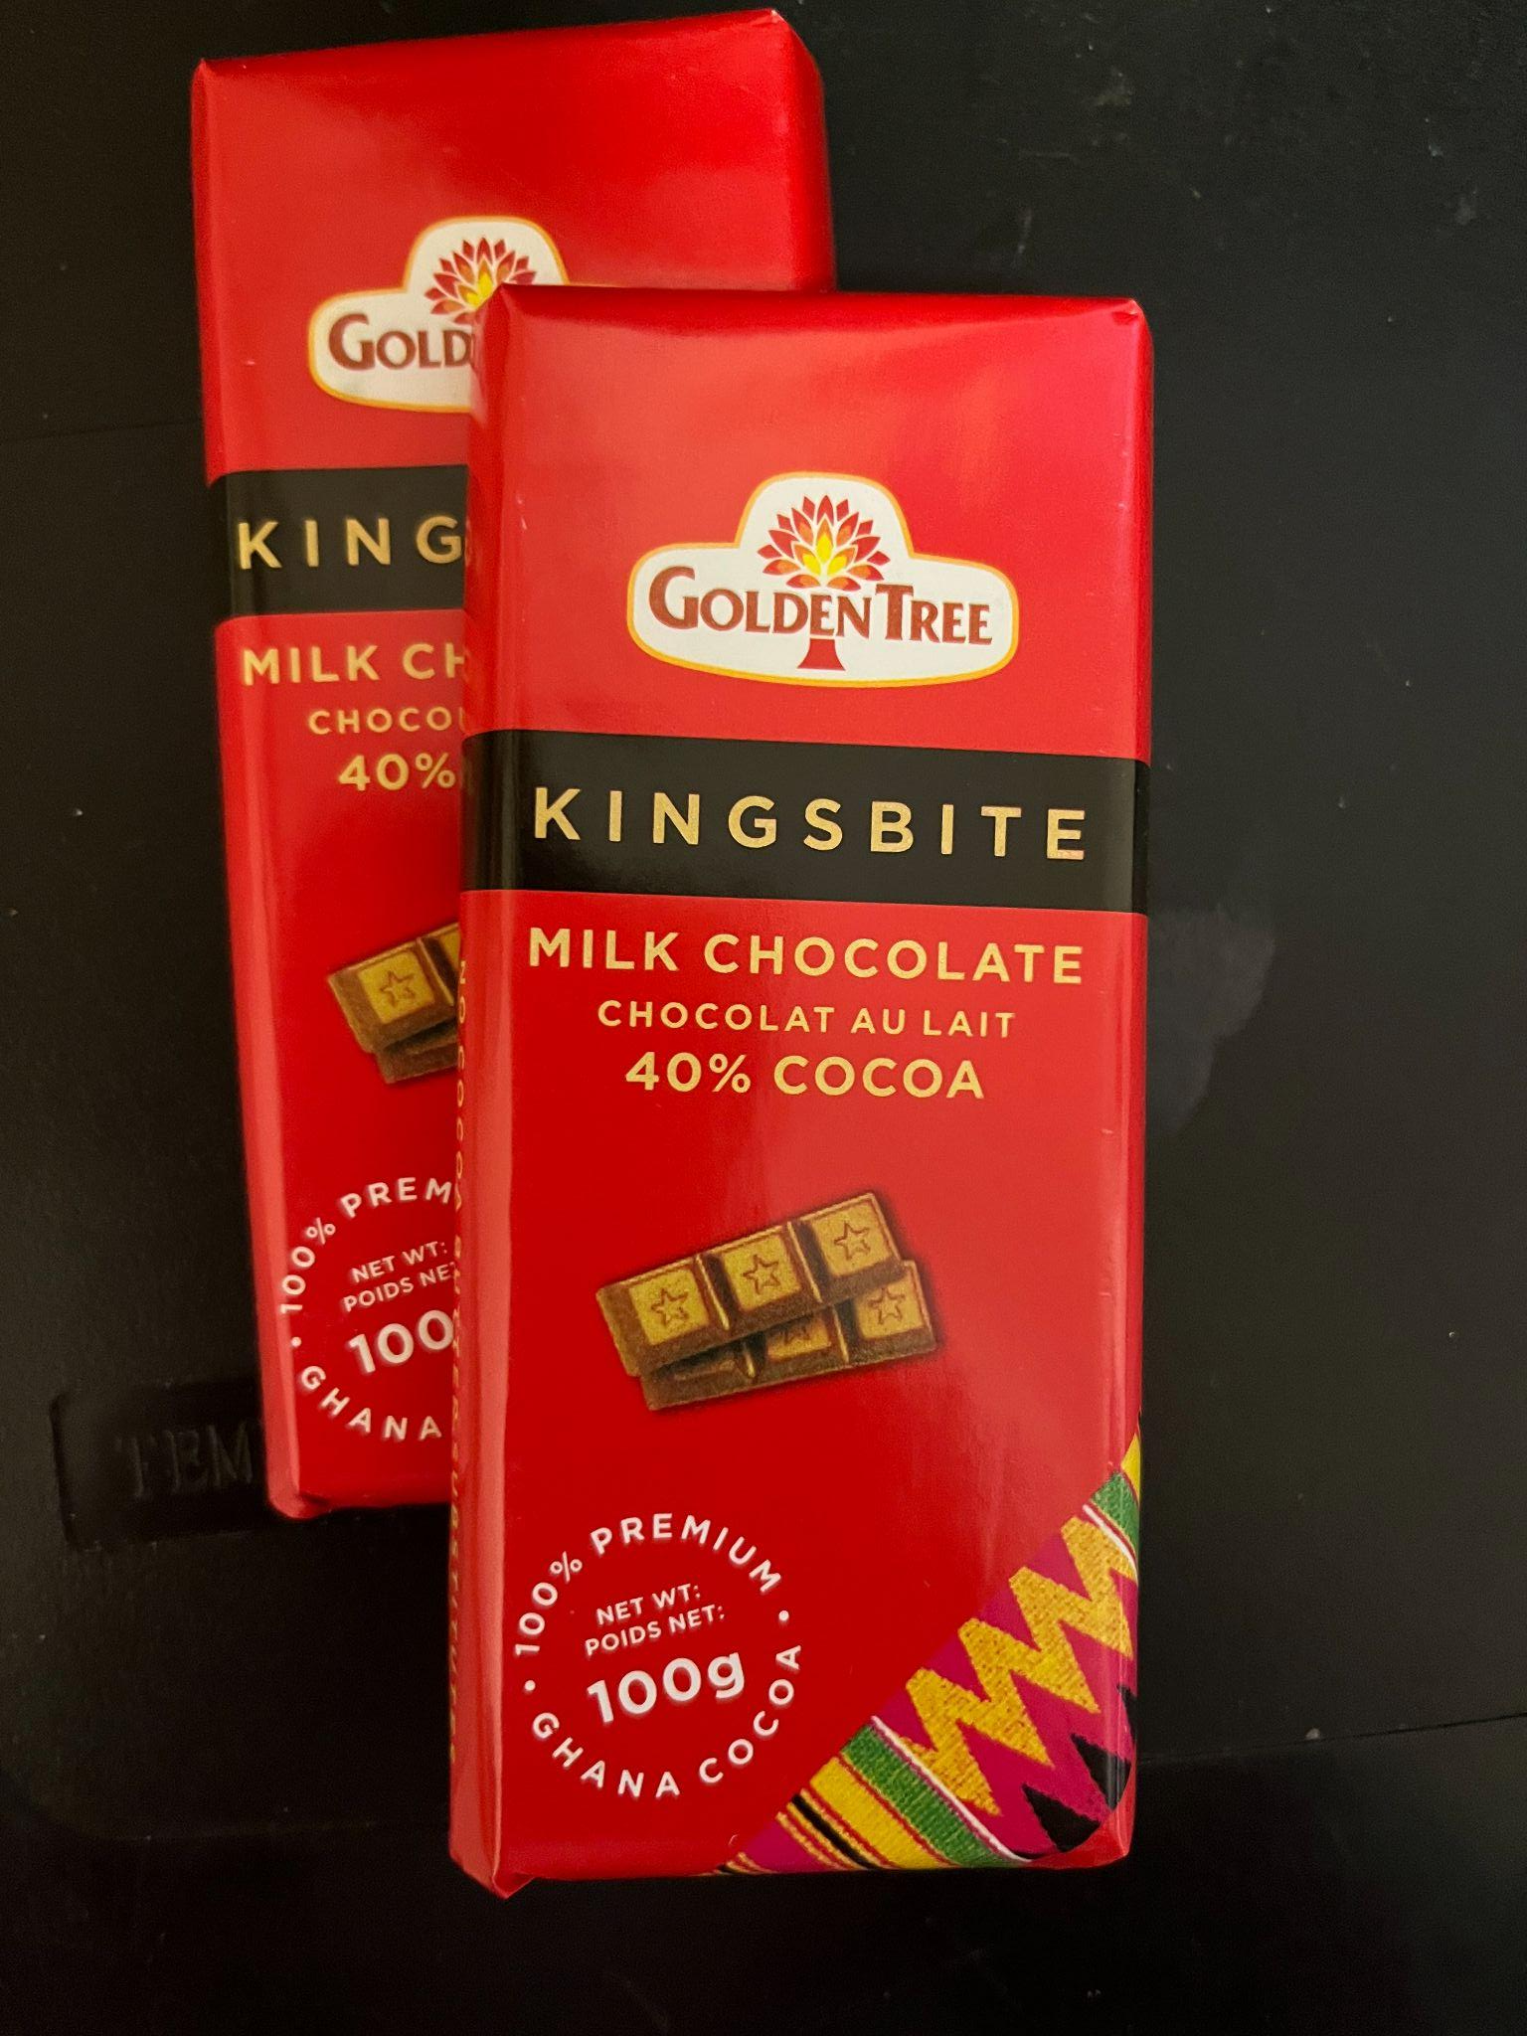
Methods of compensation
Food/Ingredients
Asking nicely.
Premium Ghanaian chocolate, bitter melon, kombucha.
So that we have more of our resources to use in the next iteration of testing.
Notes:
To allow have mopre resources for the field usability which would entail a lot more

Slide 14
Recap of our Task Flows
1
Search
For an unfamiliar food item through scanning.
2
Contextualise
Using the information provided in the app.
3
Authentic Cooking
Through recipes the user finds and/or saves.
Notes:
Scan, learn about the ingredients, and cook with your newfound knowledge

Slide 15
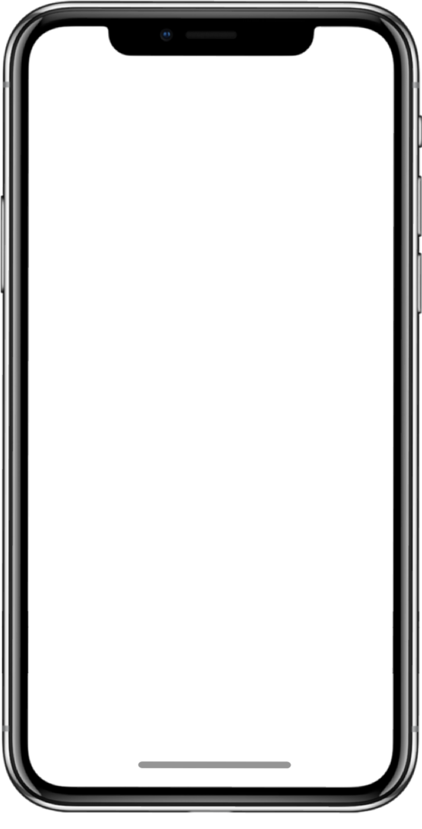
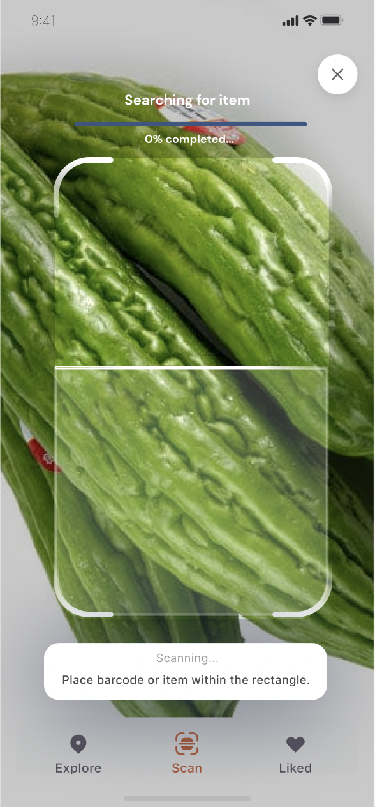
Scanning an ingredient.
We were looking to learn:
Is the scanning feature intuitive? Can users tell that this is the central functionality of the app?
Are users able to successfully scan and navigate the scanning task flow?
Where do users get stuck?
We measured:
How long it took for them to scan.
How many times they made mistakes in the scanning process and how.

Slide 16
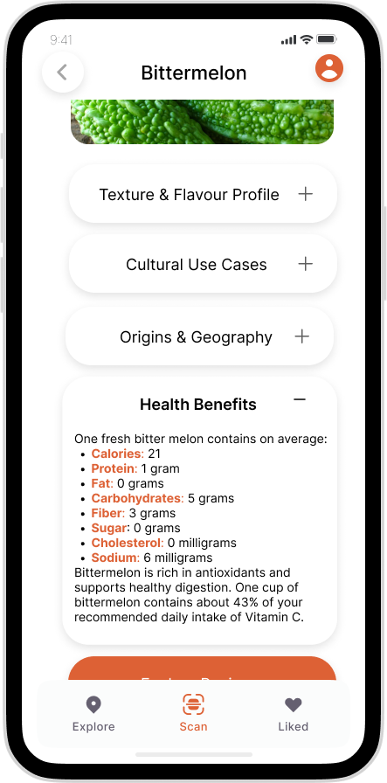
Ingredient context.
We were looking to learn:
Did the UI support the task of learning about a new ingredient?
What information is the most relevant to include?
We measured:
How long they took to read over the context.
Which information they showed more interest in.
Notes:
How much the ui supported the learning experience for them

Slide 17
Cooking with that ingredient.
We were looking to learn:
What part of the cooking process is difficult or intuitive?
Do users have trouble navigating the recipe pages?
We measured:
How long the task of reading through the recipe took.
How many times they made mistakes in the process.
Notes:
For those who were not able to cook(2), for those who were(1)

Slide 18
Procedure
When on the home page (starting screen) of the app, ask them:
Based on your initial reactions (on the home screen), what do you think you’re able to do on the app?
Allow users to scan an ingredient, or a picture of that ingredient.
Allow them to read the context while keeping in mind the questions they have about the ingredient or related recipes.
Have the participant cook with or act as if they were cooking with the ingredient. They walk us through how they think they would use it.
Time how long each task took as well as how many mistakes participants made, and in which task.
Ask our questions and allow them to ask us more about the app.
Notes:
Asked them what their initial impressions were, made them perform the tasks, measured what we were looking for and then asked them questions after

Slide 19
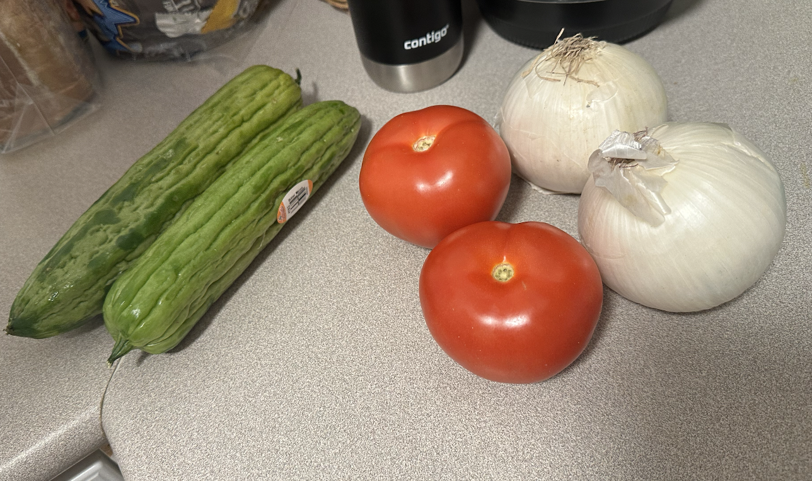
Materials & Apparatus
Bitter melon, onions, and tomatoes purchased as ingredients(Jerri, Kwame, Kai, Azana).
Jerri’s cooking utensils and kitchen in Mirrielees House.
VSCode to hard-code new recipe.
iPhone timer to measure the length of each task.
Otter.ai(for transcription)
Expo Go.

Slide 20
Location
Residence of participants
The Dishcovery team traveled to each participant’s place of residence for the study.

Slide 21
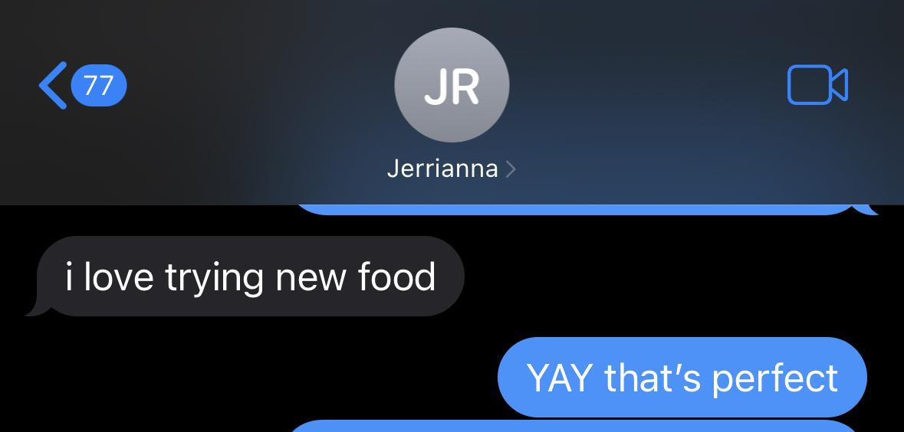
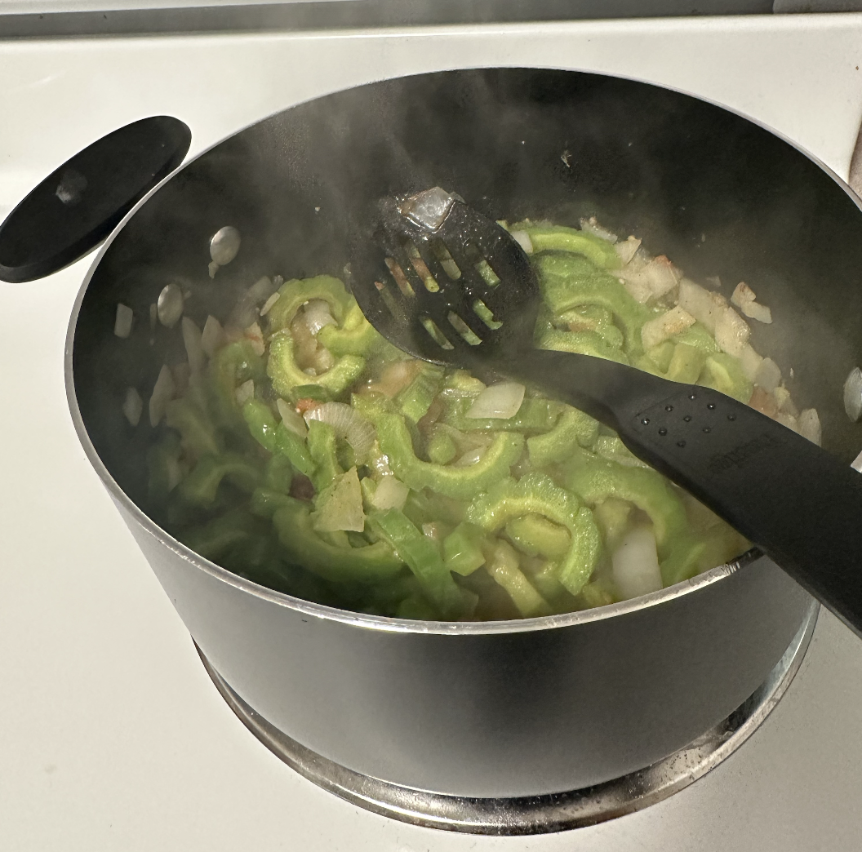
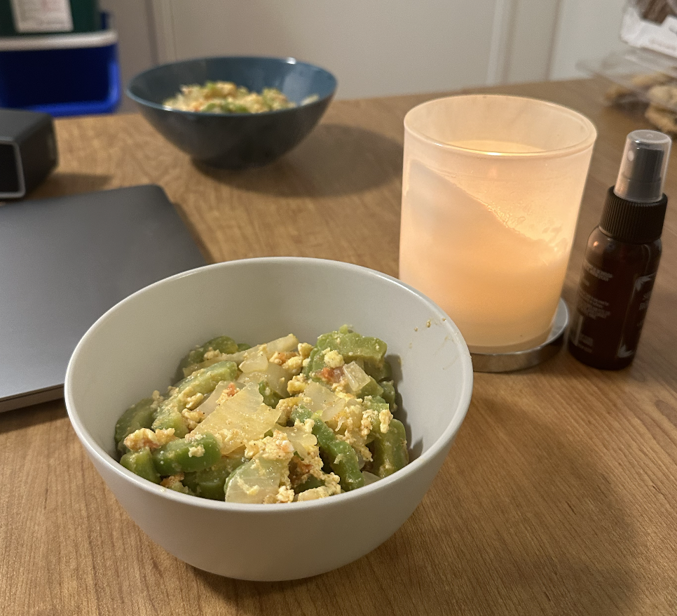
Cooking test with Jerri.
Our first time experimenting with Dishcovery on the field.

Slide 22
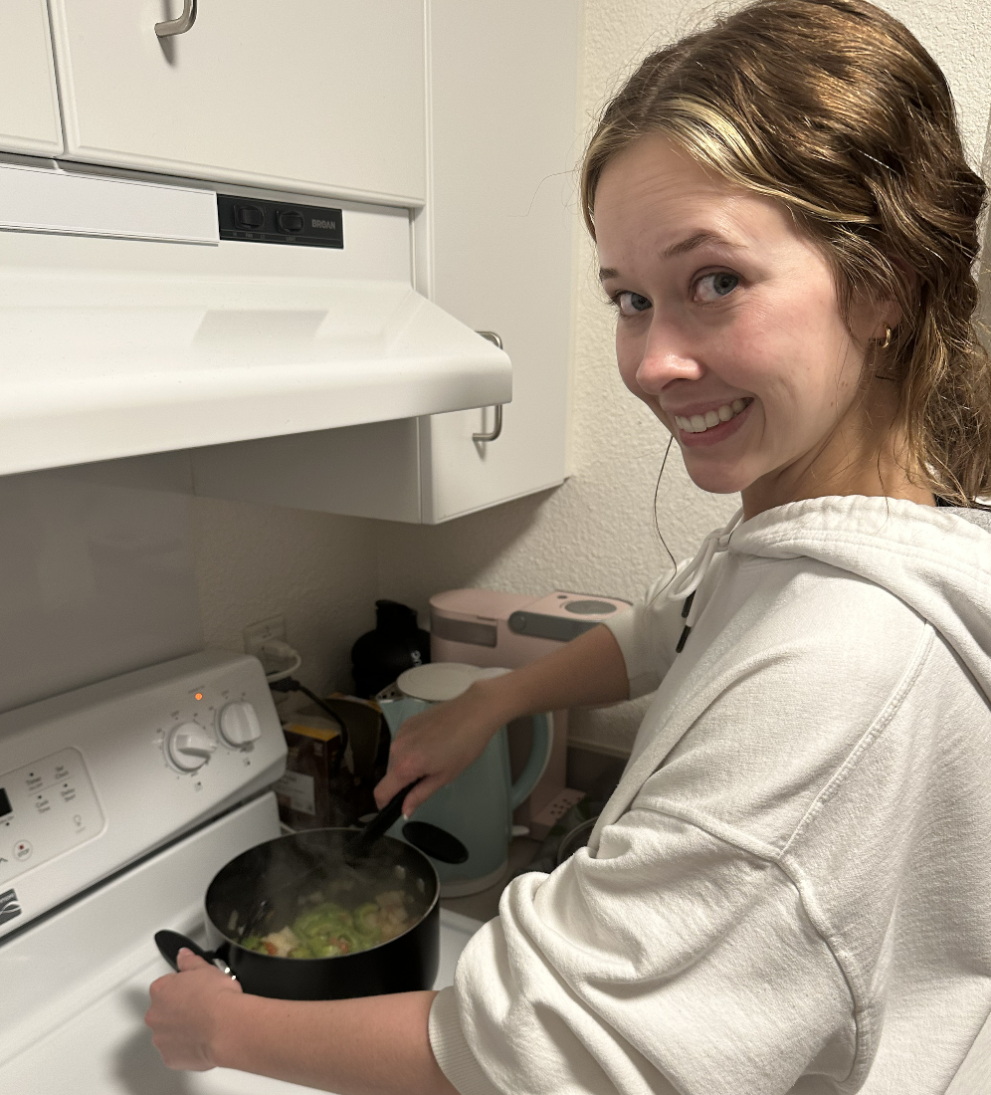
About Jerrianna
21 years old, Stanford student
From the South, has never travelled outside of the U.S.
Cooks for herself in her residence
Doesn’t pride herself in her cooking skills
Assumes the recipes she uses aren’t very authentic
Given the chance, loves to experiment with ingredients
Caveat: Saving money is important so it’s less reliable to experiment with a new ingredient then throw it away if it doesn’t work out
Notes:
A stanford student, cooks for herself, and it is important for her that the ingredients turns out useful for her

Slide 23

—Jerrianna Roper
“My favourite dish to cook is alfredo pasta. The recipe definitely isn’t authentic, but I don’t know anyone Italian or which recipe to trust.”

Slide 24
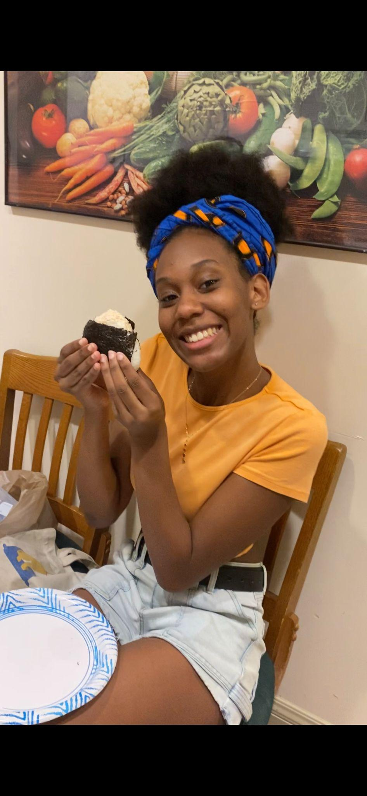
About Azana
19 year old Stanford Student
From Hawaii
Pescatarian
Cooks sometimes but doesn’t consider herself a good cook
Likes to try new recipes
New recipe she’s tried recently: Onigiri, a Japanese dish!

Slide 25
—Azana Queen
“I'm pescatarian and so, that's something else I have to take into account when like looking for recipes. I have to usually look at the ingredient list and be like, oh my, I can't eat this.”

Slide 26
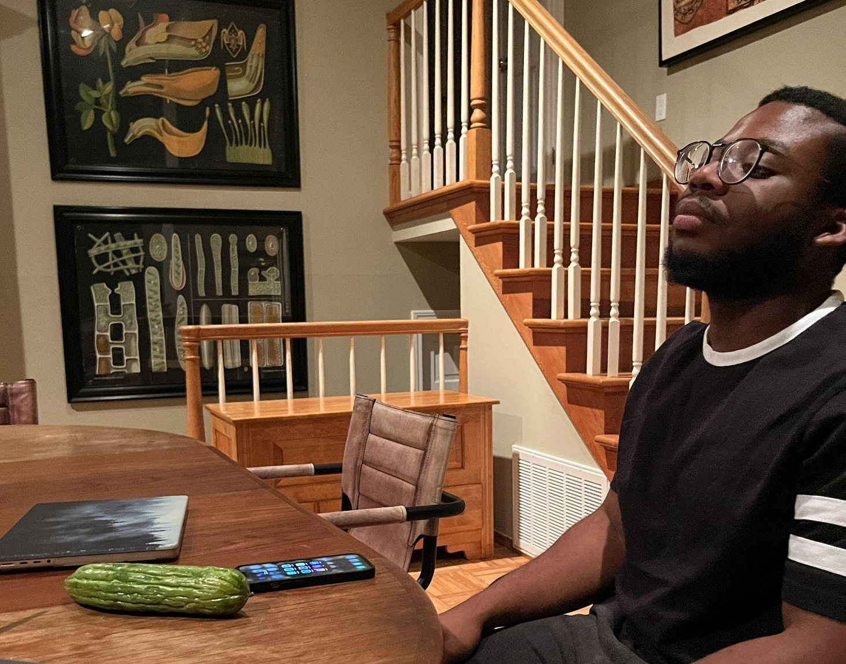
About Kwame
24 years old, Software Engineer
From Ghana, cooks for himself in his residence
Considers himself an excellent cook
Caveat: he loves to explore dishes but leans towards ingredients he is fairly familiar with.

Slide 27
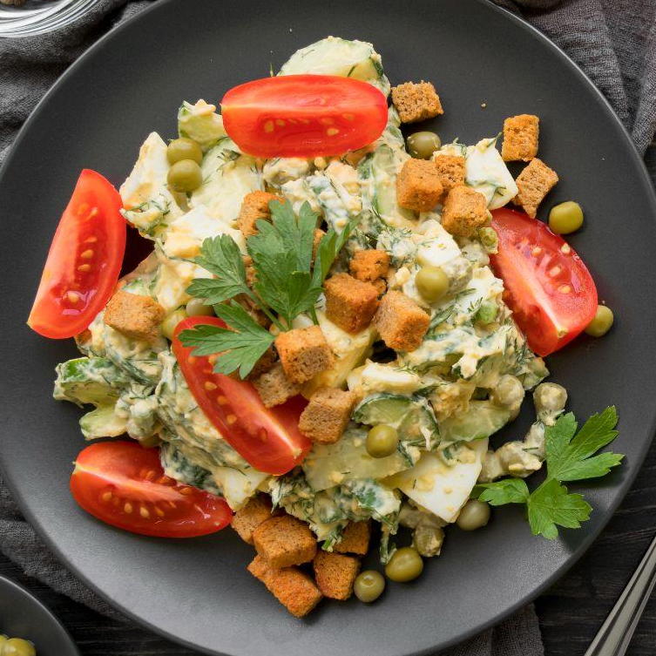
—Kwame Mensah
“I feel like if I was a little hungry, i would have been more hungry. Looking at it makes you hungry.”

Slide 28
About Kai
20 years old, product design major
From Uganda, novice in the kitchen
Says he “can’t even boil water”

Slide 29
—Kai Ssempa
“I’m always looking to incorporate new ingredients into my meals. Dishcovery makes it so easy for me to find out more about fruits and vegetables I’ve never tried before and the different recipes I can make with them”

Slide 30
Ending questions
What did you think about the use of visuals? What would you have liked more or less of?
Was the order of tasks obvious to you?
What about the interface made cooking easier? What made it harder?
Which part made you most excited to cook with bitter melon?
What other questions do you have about the ingredient or the dish?
What other questions do you have about the app?

Slide 31
03
Results

Slide 32
Quantitative data we measured
How long did each task take?
How many times did they navigate to an incorrect page when looking for something else?
How many seconds, on average, do they spend looking for a page?
Notes:
Time taken to complete tasks, hesitations and errors made in navigating pages

Slide 33
Summary - Jerriana
# of errors while looking for another screen: 1 (in task 3, Jerri accidentally entered the scan function and had to scan again)
Time taken for each task:
- Task 1: 28 seconds
- Task 2: 1min 12s
- Task 3: 25min (because we cooked)

Slide 34
Summary - Kwame
# of errors while looking for another screen: 1 (in task 2, Kwame tried to return to suggested dishes after exploring recipes after scanning)
Time taken for each task:
- Task 1: 18 seconds
- Task 2: 2 minutes 19 seconds
- Task 3: 0 min

Slide 35
Summary - Kai
# of errors while looking for another screen: 0
Time taken for each task:
- Task 1: 23 seconds
- Task 2: 1 min 38 seconds
- Task 3: 0

Slide 36
Summary - Azana
# of errors while looking for another screen: 0
Time taken for each task:
- Task 1: 27 seconds
- Task 2: 1 min 28 seconds
- Task 3: 0

Slide 37
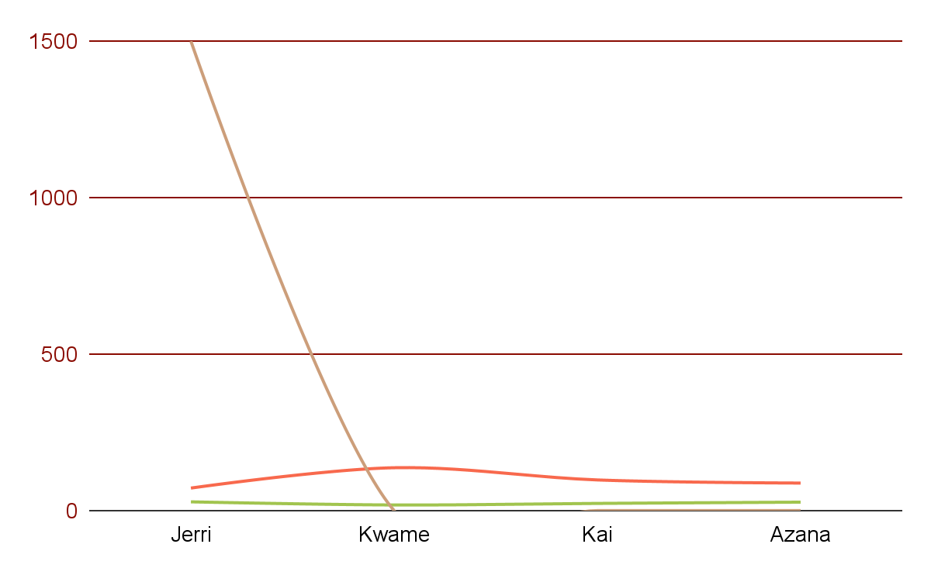
Task time graph
Task 1
Average total time = 24 s
Errors = 1
Task 2
Average total time = 98.75 s
Errors = 1
Task 3
Average total time = 375 s (not reflective of participant pool since only one cooked)
Errors = 1

Slide 38
Percentage completion of task 3
75%
25%
Of participants did not actually cook
Of participants cooked!

Slide 39
Critical incidents
Cooking new dishes
Task flow
One participant went ahead to learn about ingredients after scanning without being told
Users were excited to cook unfamiliar recipes, but were left unsure of whether it tasted authentic
Cultural Contexts
On first glance
One participant thought Dishcovery was a selling app.
Users were interested in knowing about any special holidays a dish might be prepared for / common other dishes that are paired with it
Notes:
Most of our participants were interested in trying a new recipe and learning about the dishes in their cultural context

Slide 40
04
Analysis

Slide 41
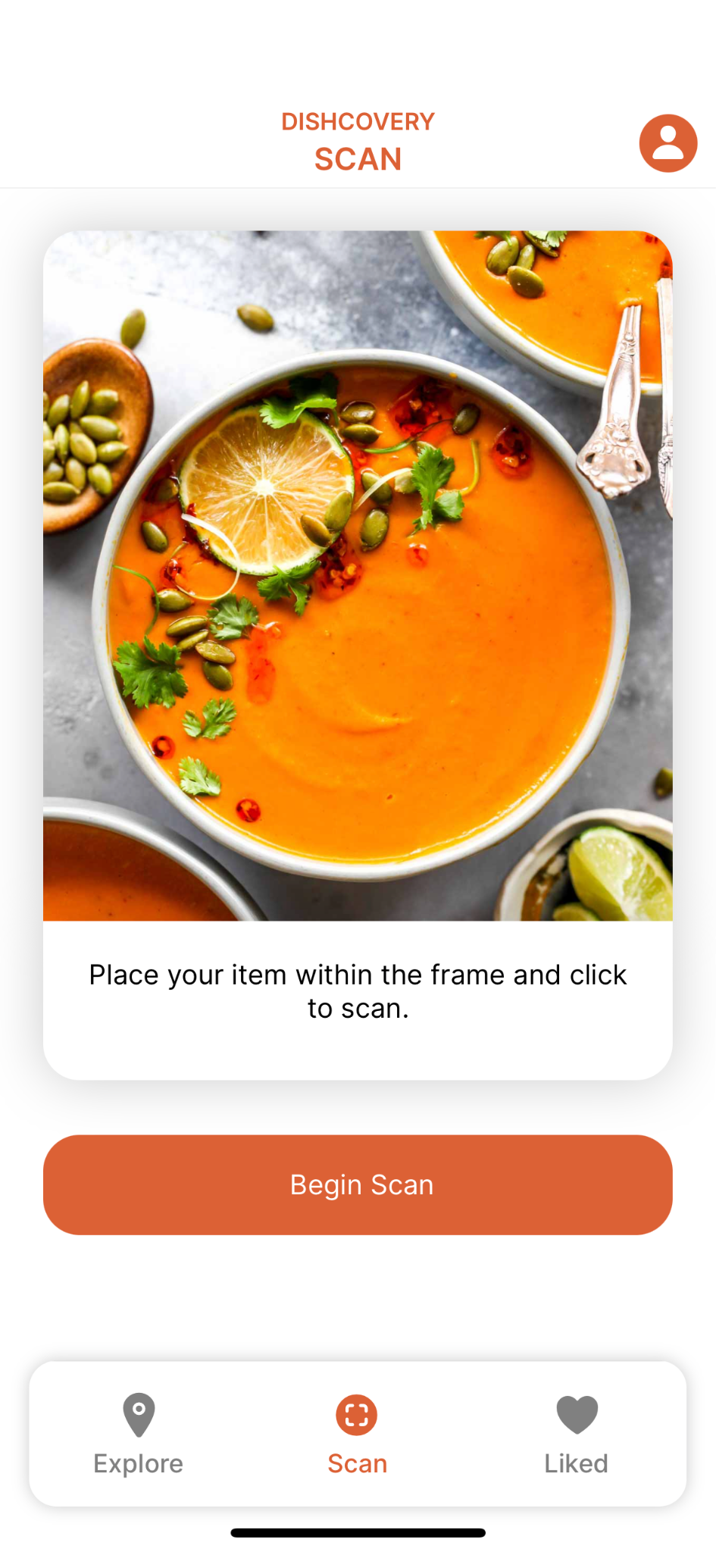
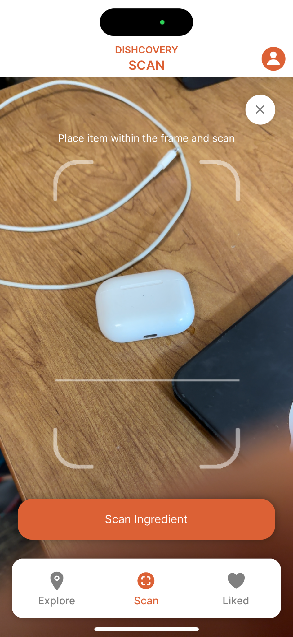
Points of hesitation
During our tests, we observed hesitation with the following:
Had to restart the process of scanning if the user deviates from viewing recipes.
While scanning, some participants were confused by having to go through two screens and buttons to scan
There was no way for a user to go back after tapping on one of the specific recipes.
Notes:
Having two different buttons,

Slide 42
Scanning an ingredient
Goal
Result
We were looking to learn:
Meh
Is the scanning feature intuitive? Can users tell that it is the central functionality of the app?
Are users able to successfully scan and navigate scanning
Where do users get stuck
Users often found challenge in knowing when their scan was complete as they expected the next page to populate. Also frustration with the many screens before scanning
We measured:
Potential Solution
How long it took for them to scan
How many times they made mistakes in the scanning process and how
As soon as the user presses the scan button in the navigation bar, have the scanning interface populate. When scans are complete, immediately bringing users to the item page.
Notes:
More details on how we redesigned according to our heuristic evaluation

Slide 43
Ingredient Context
Goal
Result
We were looking to learn:
Successful
Was it easy to read the context?
What information is the most relevant to include
There weren’t any conflicts in the material presented and what the user thought was going to happen. Average time spent on this page was in line with the amount of content on the page.
We measured:
Potential Solution
How long they took to read over the context
Which information they showed more interest in
We could seek to improve the experience by trimming out redundant information
Notes:
By trimming out redundant info, the process could be more streamlined

Slide 44
Cooking with ingredient
Goal
Result
We were looking to learn:
Meh
What part of the cooking process is difficult or intuitive?
Do users have trouble navigating the recipe pages?
There was not much going on here and users fairly did a good job estimating what the processes would entail.
We measured:
Potential Solution
How long the task of reading through the recipe took.
How many times they made mistakes in the process.
Making the cooking process a bit more guided would help keep users on track to the delicious meal!
Notes:
More details on how we redesigned according to our heuristic evaluation

Slide 45
05
Future Trajectory

Slide 46
Usability Goals
Efficiency
Learnability
Relevant context and recipes.
Scanning and browsing.
Make sure to include sufficient onboarding to make central functionality (scanning) clear.
We’ll be taking into account the information participants said they felt were most valuable on the app.
Ordering of tasks.
Discarding unnecessary steps.
Things like double scan confirmation could become more intuitive.
Giving the user the option to see recipes before reading the context, in case they have already or would not prefer to.
Notes:
More details on how we redesigned according to our heuristic evaluation

Slide 47
Suggestions from participants
Scanning
When on home page, not immediately obvious that you need to scan.
Solution: Onboarding tutorial.
Health benefits was actually the contextualisation piece that received the most interest.

Slide 48
Major fixes
Scanning
Onboarding
Re-curating context.
Having a camera preview before “Begin Scan”. And allowing users to exit scan without re-starting..
Making sure that users know the purpose of the app and when to use the scan feature.
Further investigating what users want to know when learning about an ingredient.
Notes:
Tailoring the app to the users needs

Slide 49
THANK YOU!

Slide 50
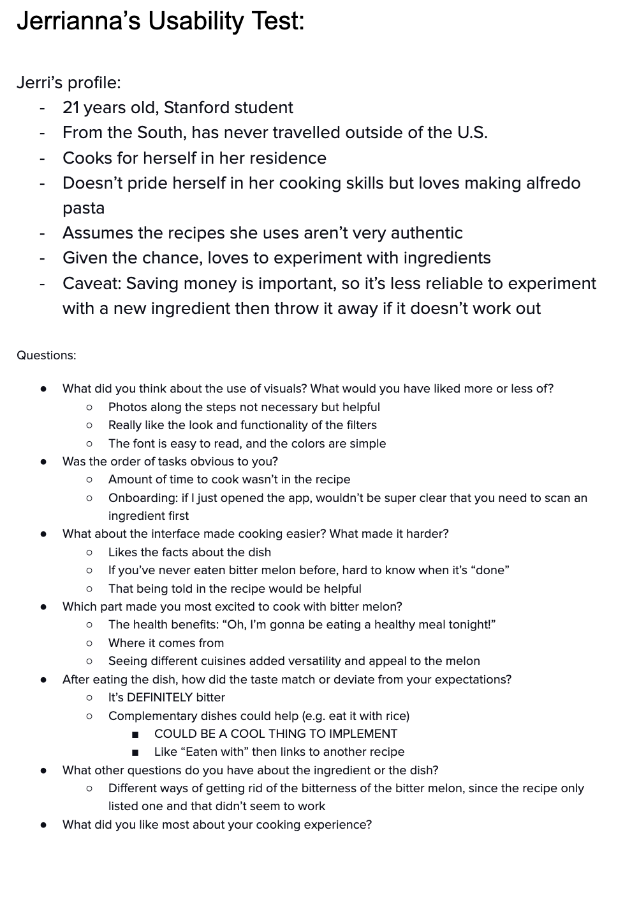
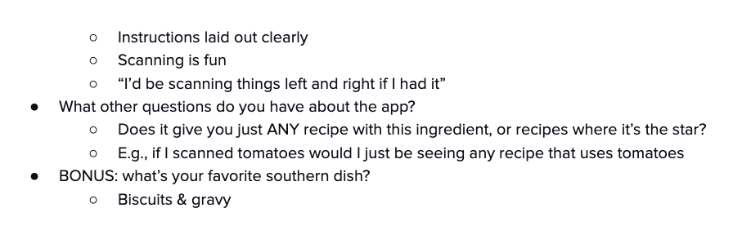
Appen-dish

Slide 51
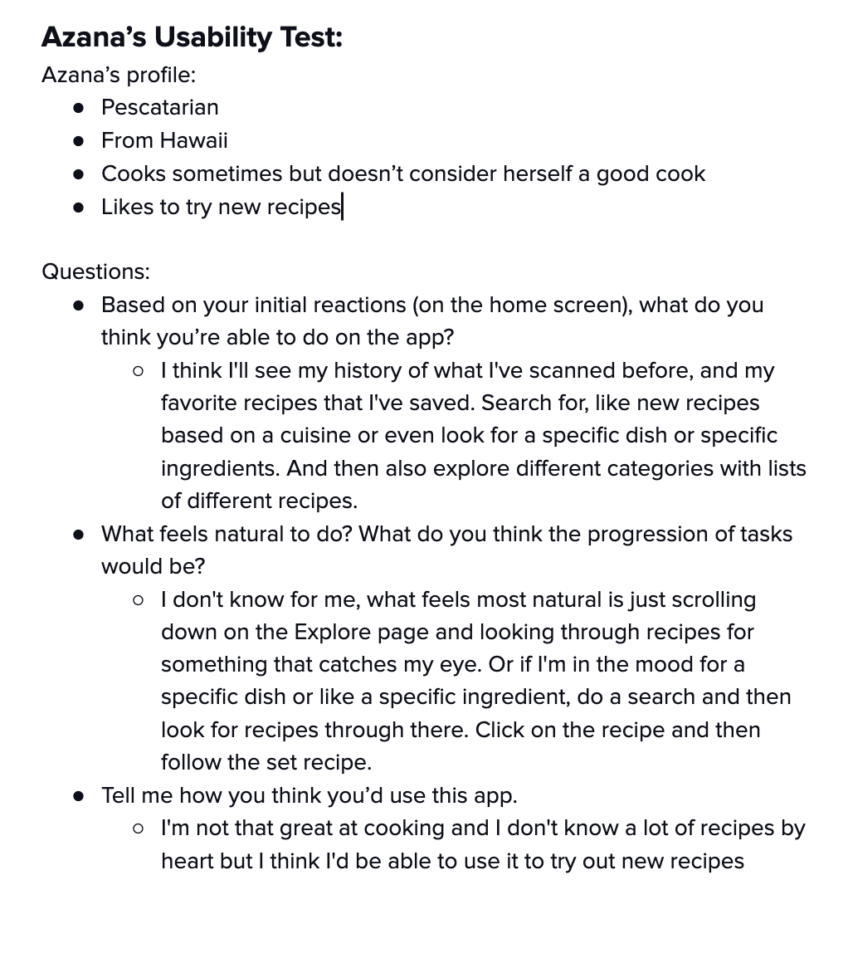
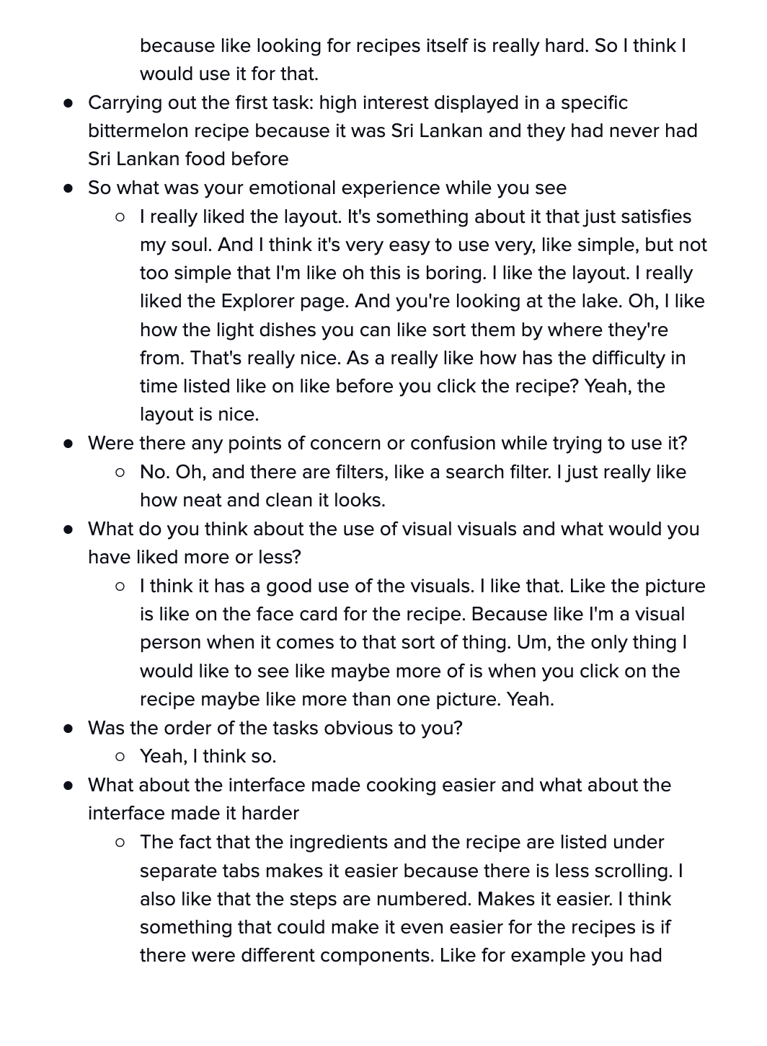
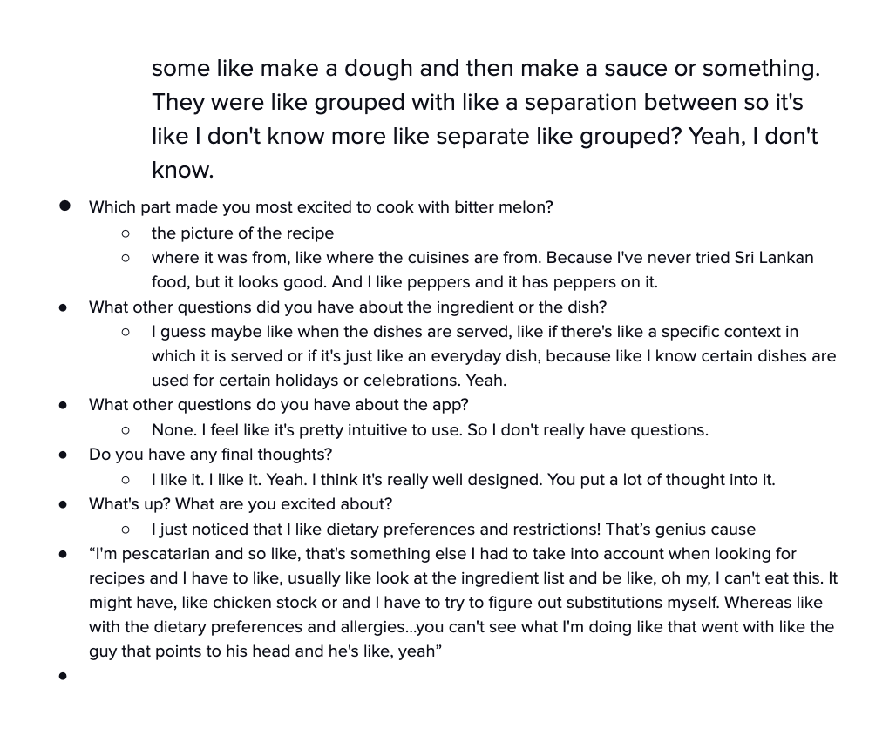
Appen-dish

Slide 52
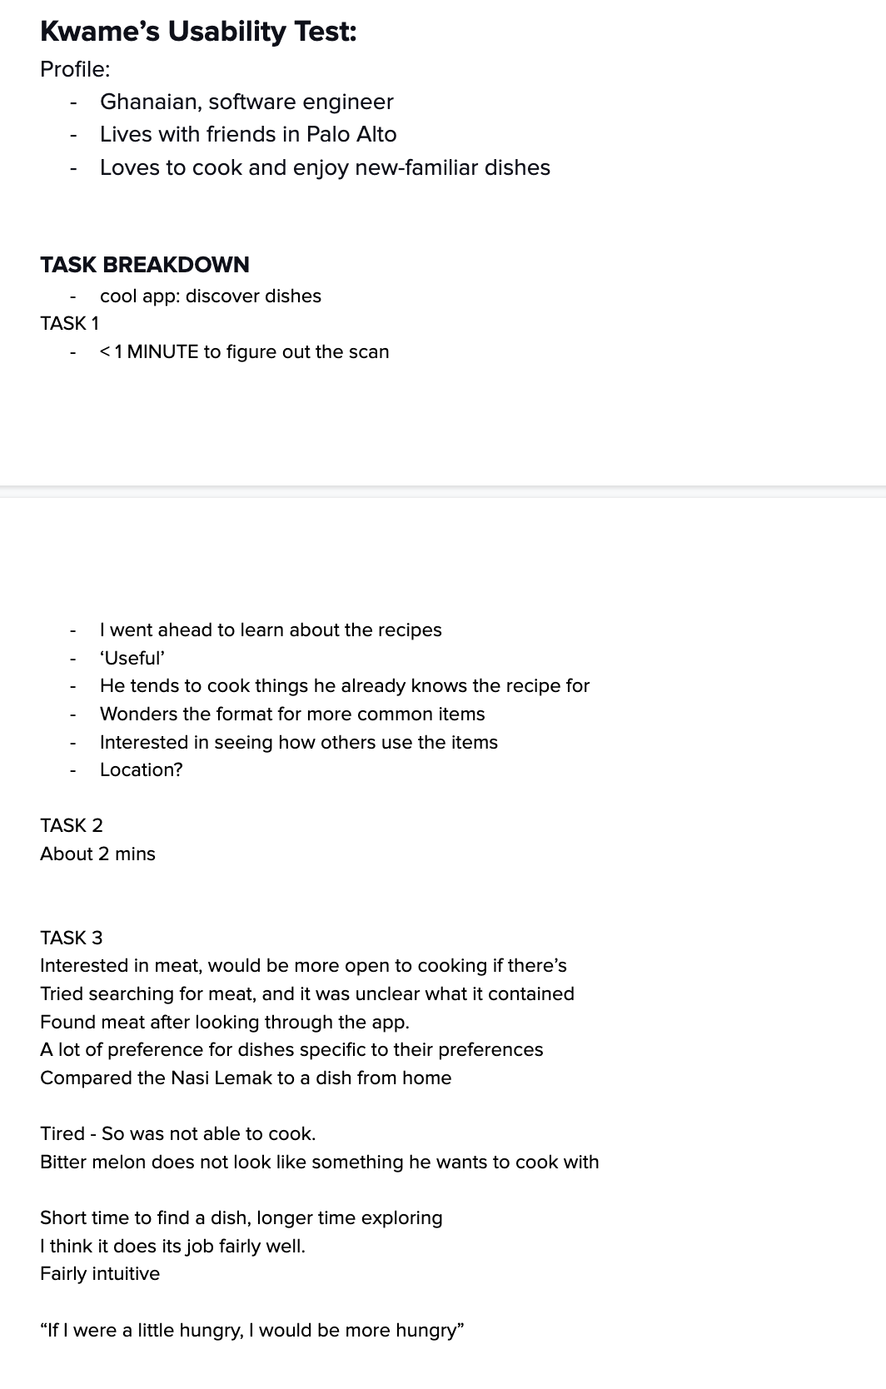
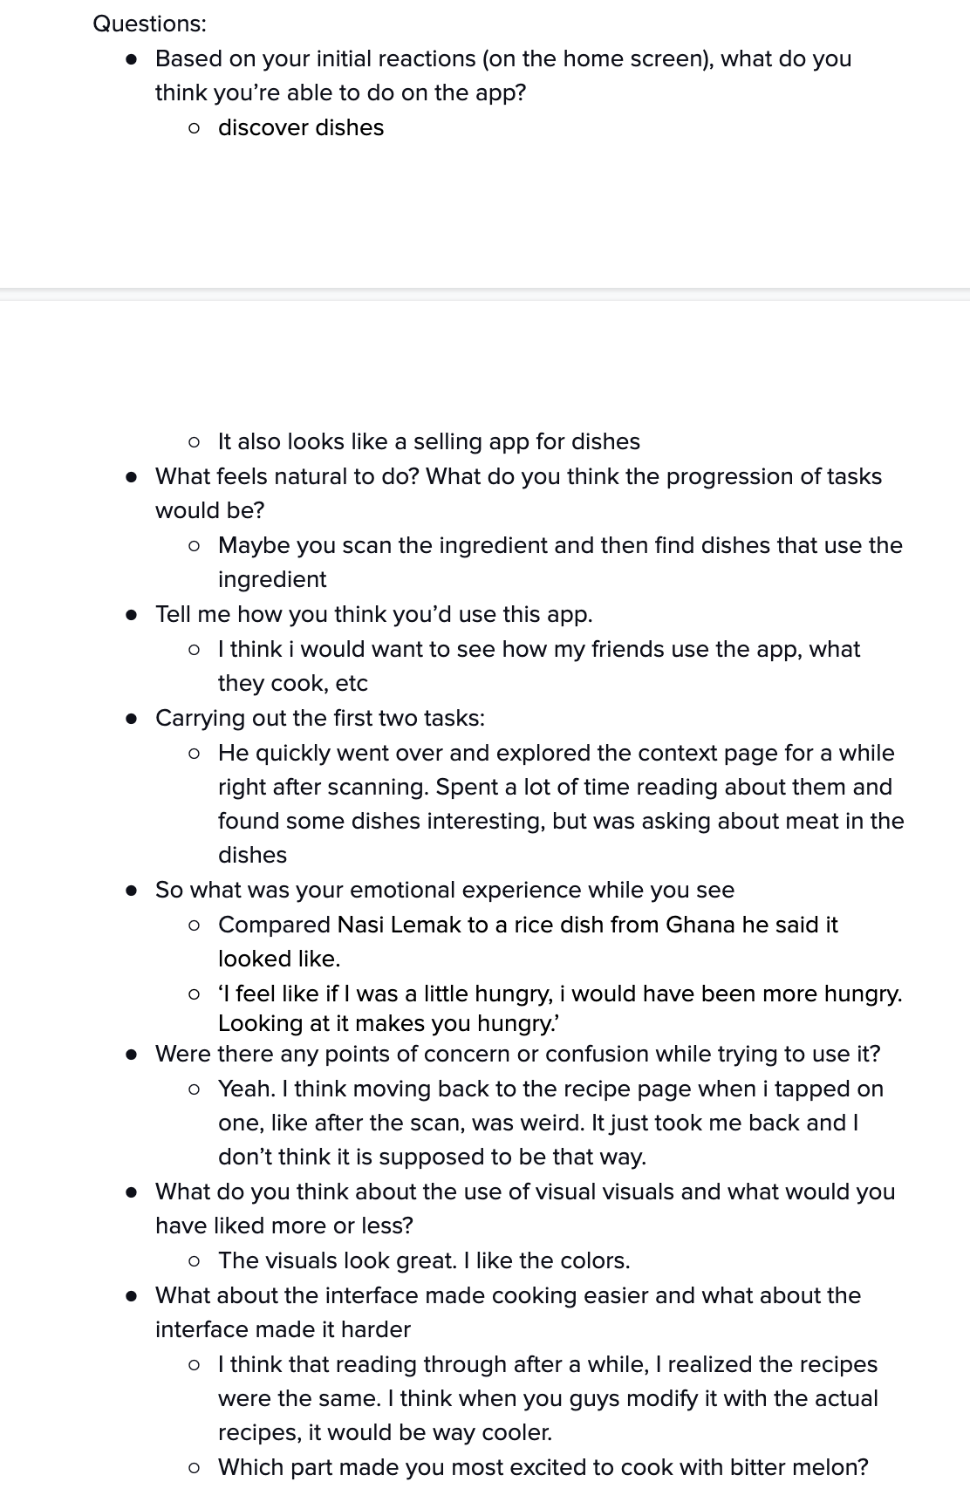
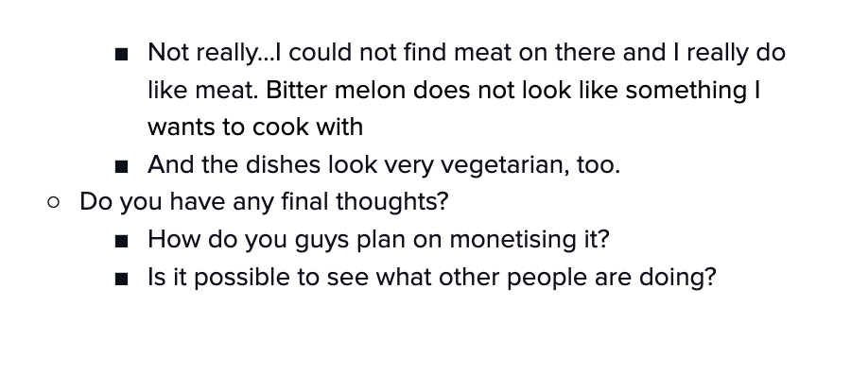
Appen-dish

